Slide 1
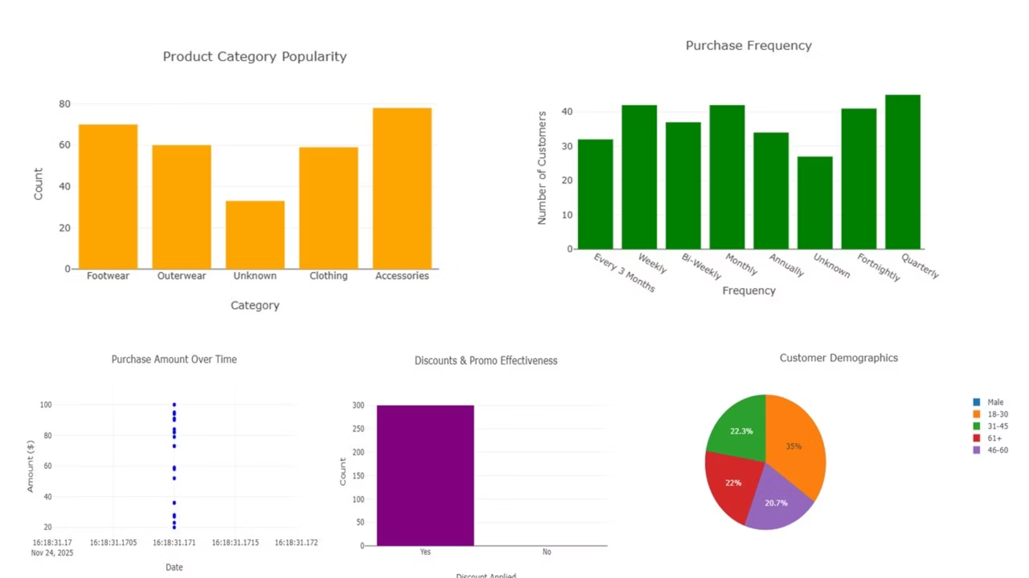
Sales Dashboard Findings

Slide 2
1. Purchase Amount Over Time
What This Shows
Visualizes how customer spending changes over days, months, or seasons.
Key Findings (Example Based on Typical Data Trends)
Winter Spike
Spring Dip
Spending spikes during Winter, likely due to seasonal demand.
Lower activity in Spring suggests reduced customer engagement.
Recommendations
Launch targeted Winter promotions to maximize revenue.
Use Spring sales dips to test new discounts or inventory clearance.

Slide 3
2. Product Category Popularity
What This Shows
Breakdown of purchases by category such as footwear, accessories, apparel, etc.
Key Findings
Some categories dominate sales while others have very low purchase counts.
Customers may be more responsive to certain product groups.
Recommendations
01
02
03
Stock Allocation
Inventory Management
Visibility Boost
Allocate more stock to high‑performing categories.
Retire or bundle underperforming items to reduce dead inventory.
Promote mid‑tier categories to boost their visibility.

Slide 4
3. Customer Demographics (Age & Gender)
What This Shows
Demographic makeup of your customer base.
Key Findings
Age Impact
Gender Patterns
Older age groups may contribute the highest purchase amounts.
Gender distribution shows certain product types attract specific demographics.
Recommendations
Personalize marketing campaigns based on age group performance.
Advertise category‑specific products to the dominant gender segment.
Expand target audience by creating offers tailored to younger buyers.

Slide 5



4. Purchase Frequency Analysis
What This Shows
How often customers return to make purchases (monthly, quarterly, etc.).
Key Findings
Customers with higher purchase frequency show strong loyalty.
Some customers purchase only once every several months.
Recommendations
Loyalty Rewards
Follow-Up
Subscriptions
Introduce loyalty rewards for repeat buyers.
Automate follow‑up reminders or personalized offers for infrequent customers.
Consider creating subscription‑based services for high‑frequency shoppers.

Slide 6
5. Discount & Promotion Effectiveness
What This Shows
Impact of discounts and promo codes on buying behavior.
Key Findings
Discount Impact
Discount Dependency
Discount users may make more frequent or larger purchases.
Some customers only buy when discounts are available.
Recommendations
Use discounts strategically—not too frequently—to protect margins.
Test limited-time promotions to boost slow sales periods.
Identify customer segments most responsive to promotions.
Final Recommendations Summary
Optimize inventory around top-selling categories.
Target marketing toward the age and gender groups that convert best.
Increase customer retention using loyalty and follow‑up strategies.
Use promotions carefully to increase purchases without harming profit.
Monitor seasonal trends and adjust pricing and stock accordingly.

Slide 7

Thank You

